Slide 1
AJAX

Slide 2
AJAX
AJAX
    Asynchronous
    Javascript
    XML
Design technique that combines technologies like Javascript and XML for responsive web pages
Prevents page transitions and thus save time and bandwidth by fetching only the relevant data from the server through background requests
First introduced by Microsoft in IE5 browser (1996 – 99) and later adopted by other browsers
Term AJAX was coined by Jesse James Garrett in 2005

Slide 3
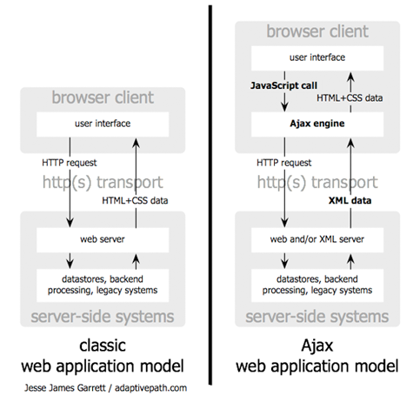
AJAX vs Classic approach

Slide 4
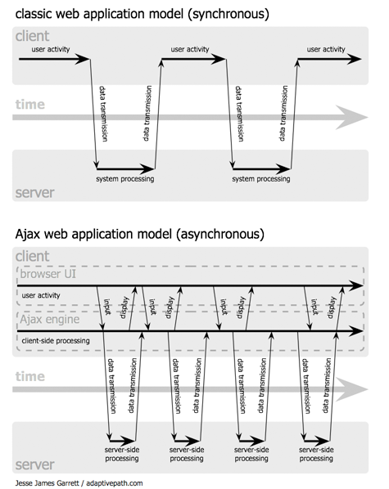
Synchronous vs Asynchronous

Slide 5
XMLHttpRequest
onreadystatechange
    Event handler to handle change in state
responseXML
    Returns received response as parsed XML
responseText
    Returns received response as plain text
readyState
    Integer (0 – 4) summarizing the state of the object
status
    Status code of response as defined in HTTP protocol
open()
    Opens a connection with the server
send()
    Sends a request along with request parameters

Slide 6
ReadyState
0: not initialized.
1: connection established.
2: request received.
3: answer in process.
4: finished.

Slide 7
Simple AJAX request
var xhr;
// instantiate
if (window.XMLHttpRequest) // Standard object
{
xhr = new XMLHttpRequest(); // Firefox, Safari, ...
}
else if (window.ActiveXObject) // Internet Explorer
{
xhr = new ActiveXObject("Microsoft.XMLHTTP");
}
// assign callback function
xhr.onreadystatechange = callback;
//open connection
xhr.open(“GET”,url,true);
xhr.send();

Slide 8
Callback
function callback() {
if(xhr.readyState == 4) {
if(xhr.status == 200)
alert("Received:" + xhr.responseText);
else
alert("Error code " + xhr.status);
}
}

Slide 9
An AJAX wrapper
function ajax(method,url,mode,handler,caller){
this.requestMethod = method;
this.requestUrl = url;
this.ajaxMode = mode;
this.xmlhttp = new XMLHttpRequest();
this.xmlhttp.parent = this;
this.callBack = handler;
this.callerObject = caller;
this.send = function(){
this.xmlhttp.onreadystatechange = function(){
if(this.readyState == 4 && this.status == 200){
this.parent.callBack(this.responseText,this.responseXML,this.parent.callerObject);
}
}
this.xmlhttp.open(this.requestMethod,this.requestUrl,this.ajaxMode);
this.xmlhttp.send();
}
}

Slide 10
Same Origin Policy
Security restriction
    Browser allows reading data from resources that belong to same origin only
    Origin is same when the following three match
      Scheme
      Host
      Port
    Implications:
      Resource in one domain can send a request to resource in another domain
      Resource in one domain CANNOT read response from another domain

Slide 11
Potential Security Threat
User access www.gmail.com to check her inbox
User credentials are stored in cookies
User access a malicious website
Malicious website sends a request to gmail.com
User credentials stored in cookies are automatically sent to gmail.com and based upon that user inbox is retrieved
Malicious website can now access user emails

Slide 12
Exceptions to Same Origin Policy
<script></script>
<link></link>
<img></img>
<a></a>

Slide 13
Cross-domain AJAX restriction
XMLHttpRequest is not granted an exception to same origin policy since XMLHttpRequest can be used to read response from a cross-domain site
AJAX request cannot be made to a cross-domain site using XMLHttpRequest
    May include:
      Sending request
      Retrieving response

Slide 14
Cross-domain AJAX alternatives
Img
    Can be used to send a GET request
Using Script tag and jsonp
    Can be used to send a GET request and obtain a response
Using Iframe
    Can be used to send a GET as well as POST request and obtain a response
    Works only for subdomains sharing same document.domain
CORS

Slide 15
IFRAME vs XMLHttpRequest
IFRAME
    Works for all (including older) browsers
    Cross-domain requests to subdomains
    Allows file uploads and downloads
XMLHttpRequest
    Cleaner, faster and easier
    Cross-domain requests only using CORS
    File uploads using FormData – not supported in every browser
    File download is not easy

